Slide 1
NTE 1010.1 - Introduction to Finance for Engineers
Spring 2020
week 1
Introduction

Slide 2
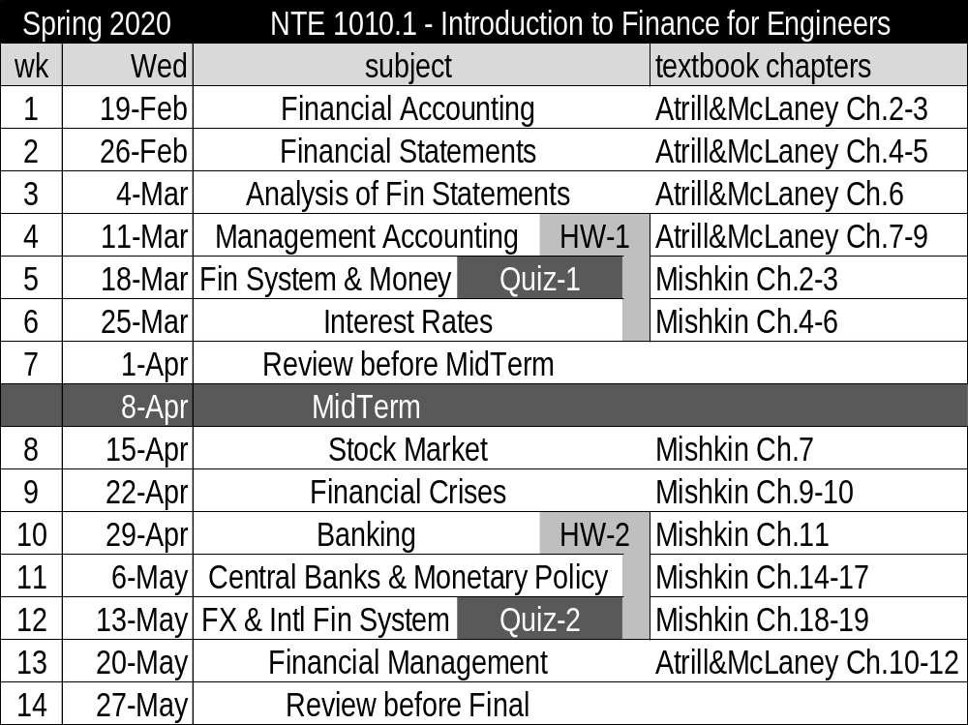
NTE 1010 – Introduction to Finance for Engineers
Spring 2020 - Course Contents & Weekly Schedule

Slide 3

NTE 1010 – Introduction to Finance for Engineers
Exams & Recommended Reading
  At the exams,
  you will need to have a calculator which can calculate power of a number.
      You may not use computers, telephones or any other electronic equipment of that sort.
      You may refer to an A4-sized sheet with formulas & notes on both sides
      and to the A3-sized table of Time Value Factors.
      All other notes and books are not to be referred to.
  Every week, after the lecture, lecture notes will be uploaded to internet, DISCORD
    you may reach to them via the following link: https://discord.gg/J3gVqr3

Slide 4
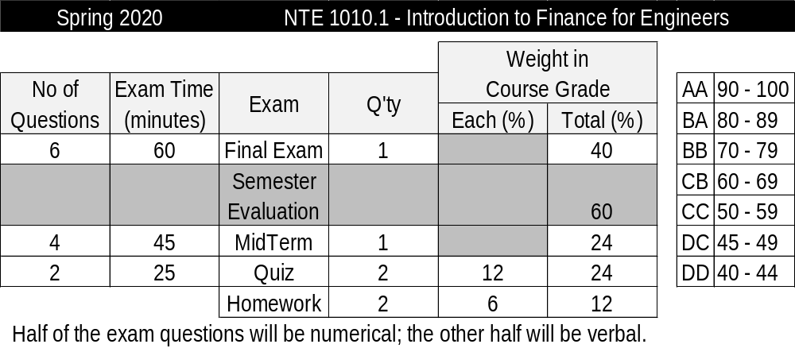
NTE 1010 – Introduction to Finance for Engineers
Spring 2020 - Course Grading

Slide 5
Finance for Engineers

Slide 6
NTE 1010 – Introduction to Finance for Engineers
Finance for Engineers
Functions in a Company
Basic functions in a company are the following:
    Procurement (for production and trading companies)
    Production (for production companies)
    Sales
    Information Technologies, IT
    Human Resources, HR
    Accounting
    Finance
Finance
& Accounting
Sales
Production
Procurement
IT
HR

Slide 7
NTE 1010 – Introduction to Finance for Engineers
Finance for Engineers
Finance Function
  Finance uses
  internal information (basically accounting data such as
  Balance Sheet, Income Statement, Cash Flow)
  and external information to perform its job.
  Basic external info neded (actual as well as forecasts) are
  interest rates,
  FX rates & devaluation,
  inflation,
  growth rates of economy and markets.
  Financial Management takes care of
  the ″money side″ of the business.

Slide 8
NTE 1010
Introduction to Finance for Engineers
Financial Accounting

Slide 9
NTE 1010 – Introduction to Finance for Engineers
Introduction
Financial Accounting
  Accounting is concerned with
  collecting, analysing and communicating
  financial information.
  This information is useful for
  those who need to make decisions and plans about businesses,
  and for those who need to control those businesses.
  Finance is concerned with the ways in which funds for a business are raised and invested.
  Finance, like accounting, exists to help decision makers.
  A high-level of understanding of accounting and finance
  is required by most engineers within a company in order to be able to
  communicate better with the managers and accounting staff of the company.

Slide 10
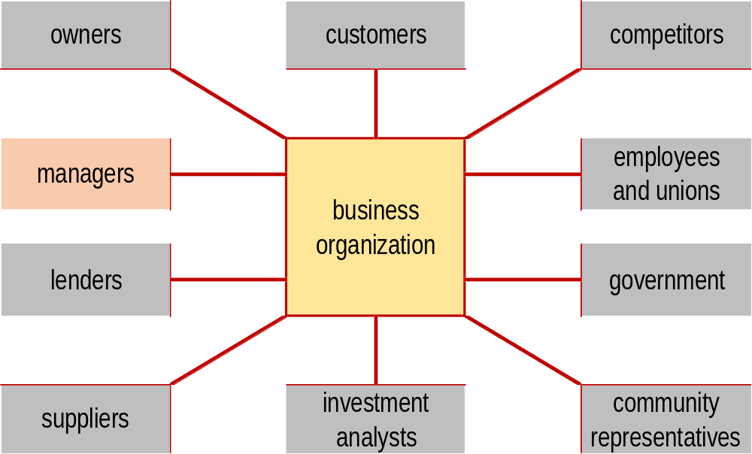
NTE 1010 – Introduction to Finance for Engineers
Financial Accounting
Main users of financial information relating to a business

Slide 11
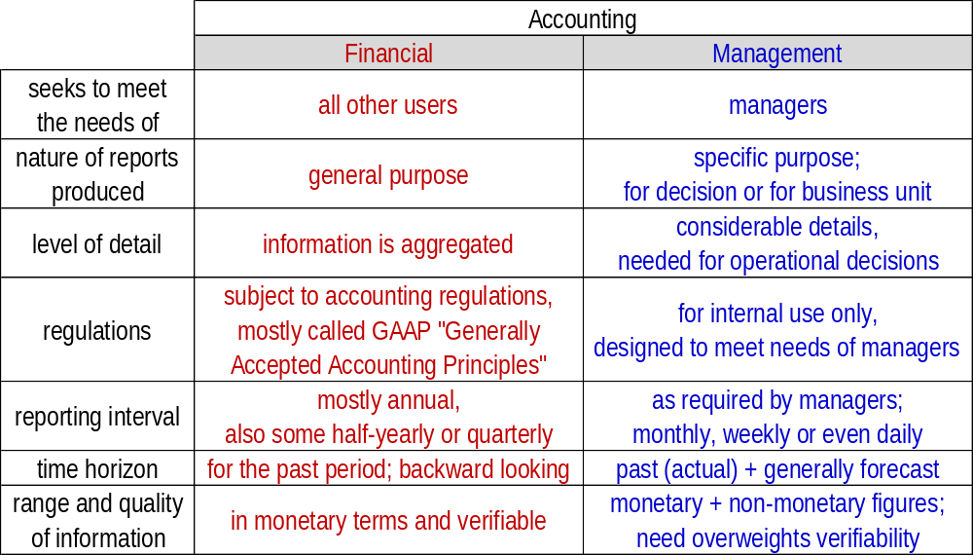
NTE 1010 – Introduction to Finance for Engineers
Financial Accounting versus Management Accounting

Slide 12
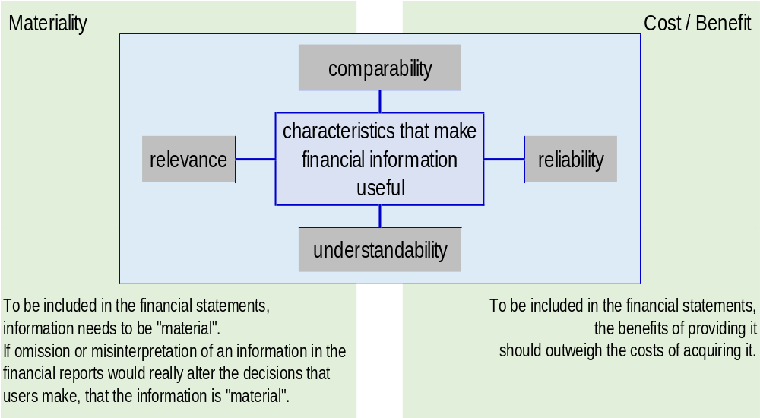
NTE 1010 – Introduction to Finance for Engineers
Financial Accounting
Usefulness of financial information

Slide 13

NTE 1010 – Introduction to Finance for Engineers
Financial Accounting
Accounting as Information System

Slide 14
NTE 1010 – Introduction to Finance for Engineers
Financial Accounting
Accounting Principles and Conventions
  Each country has a different variation of ″Generally Accepted Accounting Principles″.
  For example, GAAP accepted in Turkey are called TR GAAP, in USA as US GAAP.
  A version that is harmonized internationaly is called IFRS,
  ″International Financial Reporting Standards″.
  Although it is not necessary to have a detailed understanding of GAAP or IFRS
  in order to understand the financial statements,
  it is necessary to understand
  some of the basic accounting principles and conventions:
  Business Entity
  The business and its owners are treated separately for the purposes of accounting;
  this differs from the legal treatment.
  Accrual Accounting
  Historical Cost

Slide 15
NTE 1010 – Introduction to Finance for Engineers
Basic Accounting Principles and Conventions
Business Entity
  The business and its owners are treated separately for the purposes of accounting;
  this differs from the legal treatment.
  The three main forms of legal structures of a business are
  Sole propriertorship (şahıs şirketi)
  where owner is personally responsible for the debts of the business,
  Partnership (adi ortaklık)
  where partners are ″jointly and severally responsible″
  meaning that creditors can attempt to recover bad debts
  from all the owners, or each one separately, in their personal capacities,
  Corporation (şirket)
  where the most that the owners can lose is their equity investment in the company.

Slide 16
NTE 1010 – Introduction to Finance for Engineers
Basic Accounting Principles and Conventions
Accrual Accounting
  Accrual accounting recognises a sale when it occurs, that is, when the sale documents are signed, not when the customer finally pays the cash in settlement.
  If the transaction occurs before the cash transfer, the tranaction is accrued,
  and if the transaction is recognised after the cash transfer, it is deferred.
  For example, deferred taxation is the recognition of taxes owed but not paid yet.
  Because of the difference in timing between the recognition of a transaction and cash receipt or payment, there is the need to match the expenses to the correct period in which the revenue is recognised. Matching expenses and revenues allows for
  the correct calculation of the profit that a company has made in a particular period.
  On the other hand, the cost of an asset with a useful life of longer than a year
  is spread out over its expected useful life.
  This procedure is called depreciation.

Slide 17
NTE 1010 – Introduction to Finance for Engineers
Basic Accounting Principles and Conventions
Accrual Accounting
  Accrual accounting recognises a sale when it occurs,
  that is, when the sale documents are signed,
  not when the customer finally pays the cash in settlement.
  If the transaction occurs before the cash transfer,
  the tranaction is accrued,
  and
  if the transaction is recognised after the cash transfer,
  it is deferred.

Slide 18
NTE 1010 – Introduction to Finance for Engineers
Basic Accounting Principles and Conventions
Historical Cost
  The figures in the accounts represent historical values,
  i.e. the cost of acquiring the assets or goods at the date of acquisition.
  The value of an asset in the accounts, that is, its ″book value″ is unrelated to its value
  either within the business (replacement value) or to its value to others (market value).
  Although this seems unrealistic, historical cost reporting removes the requirement
  for valuation based on subjective opinion,
  which could result in manipulation of the financial position.
  This convention also removes the need to adjust the figures for inflation.
  Nevertheless, in high inflation environments (where cumulative inflation rate over three years exceeds 100%), ″inflationary accounting″ is allowed.
  This is also in accord with the conservative position adopted by accounting. For example, if losses are probable, and can be reasonably estimated, they are recorded. However, if gains ocur, these are only recorded when they occur.

Slide 19
NTE 1010 – Introduction to Finance for Engineers
Basic Accounting Principles and Conventions
Historical Cost
  The figures in the accounts represent historical values,
  i.e. the cost of acquiring the assets or goods
  at the date of acquisition.
  The value of an asset in the accounts,
  that is, its ″book value″ is unrelated to its value
  either within the business (replacement value)
  or to its value to others (market value).

Slide 20
NTE 1010.1 – Introduction to Finance for Engineers
Major Financial Statements
Additional Accounting Conventions
  Money Measurement
    Resources not capable of being measured in monetary terms will be excluded.
    Accounting normally deals with only those items that are capable of being expressed in monetary terms. Money has the advantage that it is a useful common denominator with which to express the wide variety of resources held by a business.
  Going Concern
    Financial statements are to be prepared on the assumption that
    the business will continue operations for the foreseeable future,
    unless this is known not to be true.
    In other words, it is assumed that there is no intention, or need, to sell off the non-current assets of the business. Based on this assumption, it is prudent to continue to show the value of non-current assets at their recorded values (that is, based on historic cost).

Slide 21
NTE 1010.1 – Introduction to Finance for Engineers
Major Financial Statements
Additional Accounting Conventions
  Dual Aspect
    Each transaction has two aspects, both of which will affect the balance sheet.
    The purchase of a car for cash results in an increase in one asset (vehicles) and a decrease in another (cash). The repayment of a bank loan results in the decrease in a liability (loans) and the decrease in an asset (cash / bank).
  Prudence
    Financial statements should err on the side of caution.
    The convention represents an attempt to deal with the uncertainty surrounding many events reported in the financial statements, and evolved to counteract the excessive optimism of some managers and owners, which resulted in an overstatement of financial position.
  Objectivity convention seeks to reduce personal bias in financial statements.
    Financial statements should be based on objective verifiable evidence
    rather than on matters of opinion.

